Slide 1
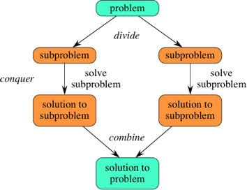
Divide and Conquer

Slide 2
Definition
In computer science, divide and conquer is an algorithm design model based on multi-branched recursion.

Slide 3
Working modal
A divide and conquer algorithm works by recursively breaking down a problem into two or more sub-problems of the same or related type, until these become simple enough to be solved directly

Slide 4
Three Step Process
Divide/Break:
the problem into a number of sub-problems that are smaller instances of the same problem.
Conquer/Solve
the sub-problems by solving them recursively. If they are small enough, solve the sub-problems as base cases
Merge/Combine
the solutions to the sub-problems into the solution for the original problem
Because divide-and-conquer creates at least two sub-problems, a divide-and-conquer algorithm makes multiple recursive calls.

Slide 5
Continue…

Slide 6
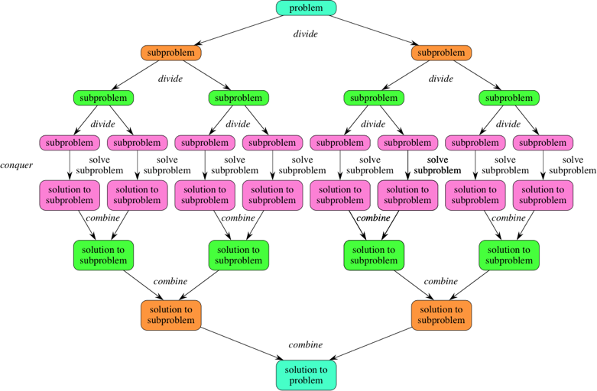
Continue…
If we expand out two more recursive steps, it looks like this:

Slide 7
Examples
Merge Sort
Quick Sort
Binary Search
Strassen's Matrix Multiplication
Closest pair (points)

Slide 8
MergeSort
MergeSort is a divide and conquer method of sorting

Slide 9
MergeSort Algorithm
MergeSort is a recursive sorting procedure that uses at most O(n lg(n)) comparisons.
To sort an array of n elements, we perform the following steps in sequence:
If n < 2 then the array is already sorted.
Otherwise, n > 1, and we perform the following three steps in sequence:
  Sort the left half of the the array using MergeSort.
  Sort the right half of the the array using MergeSort.
  Merge the sorted left and right halves.

Slide 10
How to Merge
Here are two lists to be merged:
  First: (12, 16, 17, 20, 21, 27)
  Second: (9, 10, 11, 12, 19)
Compare12 and 9
  First: (12, 16, 17, 20, 21, 27)
  Second: (10, 11, 12, 19)
  New: (9)
Compare 12 and 10
  First: (12, 16, 17, 20, 21, 27)
  Second: (11, 12, 19)
  New: (9, 10)

Slide 11
Merge Example
Compare 12 and 11
  First: (12, 16, 17, 20, 21, 27)
  Second: (12, 19)
  New: (9, 10, 11)
Compare 12 and 12
  First: (16, 17, 20, 21, 27)
  Second: (12, 19)
  New: (9, 10, 11, 12)

Slide 12
Merge Example
Compare 16 and 12
  First: (16, 17, 20, 21, 27)
  Second: (19)
  New: (9, 10, 11, 12, 12)
Compare 16 and 19
  First: (17, 20, 21, 27)
  Second: (19)
  New: (9, 10, 11, 12, 12, 16)

Slide 13
Merge Example
Compare 17 and 19
  First: (20, 21, 27)
  Second: (19)
  New: (9, 10, 11, 12, 12, 16, 17)
Compare 20 and 19
  First: (20, 21, 27)
  Second: ( )
  New: (9, 10, 11, 12, 12, 16, 17, 19)

Slide 14
Merge Example
Checkout 20 and empty list
  First: ( )
  Second: ( )
  New: (9, 10, 11, 12, 12, 16, 17, 19, 20, 21, 27)

Slide 15
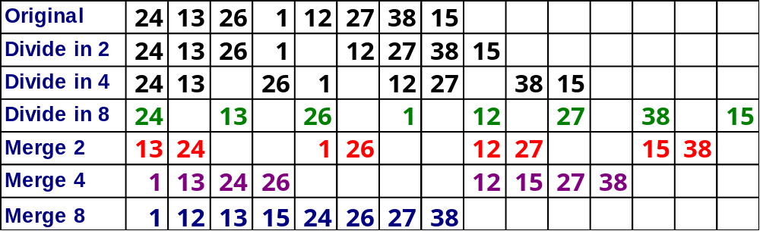
MergeSort

Slide 16
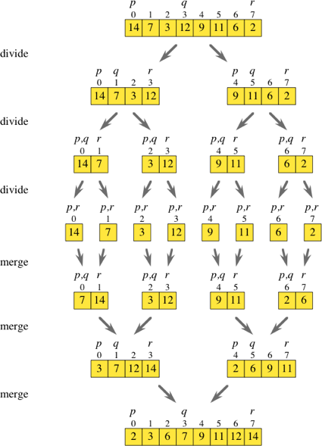
Diagrammatically explanation

Slide 17
Pseudocode
MergeSort(array A, int p, int r)
{
if (p < r)
{ // we have at least 2 items
q = (p + r)/2
MergeSort(A, p, q) // sort A[p..q]
MergeSort(A, q+1, r) // sort A[q+1..r]
Merge(A, p, q, r) // merge everything together
}
}

Slide 18
More User Friendly
MergSort(left subarray)
MergeSort(right subarray)
Merge Above Together

Slide 19
Merge-Sort Tree
An execution of merge-sort is depicted by a binary tree
  each node represents a recursive call of merge-sort and stores
    unsorted sequence before the execution and its partition
    sorted sequence at the end of the execution
  the root is the initial call
  the leaves are calls on subsequences of size 0 or 1
7 2 ⏐ 9 4 → 2 4 7 9
7 ⏐ 2 → 2 7
9 ⏐ 4 → 4 9
7 → 7
2 → 2
9 → 9
4 → 4

Slide 20
Execution Example
Partition
7 2 9 4 ⏐ 3 8 6 1

Slide 21
Execution Example (cont.)
Recursive call, partition
7 2 9 4 ⏐ 3 8 6 1
7 2 ⏐ 9 4

Slide 22
Execution Example (cont.)
Recursive call, partition
7 2 9 4 ⏐ 3 8 6 1
7 2 ⏐ 9 4
7 ⏐ 2

Slide 23
Execution Example (cont.)
Recursive call, base case
7 2 9 4 ⏐ 3 8 6 1
7 2 ⏐ 9 4
7 ⏐ 2
7 → 7

Slide 24
Execution Example (cont.)
Recursive call, base case
7 2 9 4 ⏐ 3 8 6 1
7 2 ⏐ 9 4
7 ⏐ 2
7 → 7
2 → 2

Slide 25
Execution Example (cont.)
Merge
7 2 9 4 ⏐ 3 8 6 1
7 2 ⏐ 9 4
7 ⏐ 2 → 2 7
7 → 7
2 → 2

Slide 26
Execution Example (cont.)
Recursive call, …, base case, merge
7 2 9 4 ⏐ 3 8 6 1
7 2 ⏐ 9 4
7 ⏐ 2 → 2 7
9 4 → 4 9
7 → 7
2 → 2
9 → 9
4 → 4

Slide 27
Execution Example (cont.)
Merge
7 2 9 4 ⏐ 3 8 6 1
7 2 ⏐ 9 4 → 2 4 7 9
7 ⏐ 2 → 2 7
9 4 → 4 9
7 → 7
2 → 2
9 → 9
4 → 4

Slide 28
Execution Example (cont.)
Recursive call, …, merge, merge
7 2 9 4 ⏐ 3 8 6 1
7 2 ⏐ 9 4 → 2 4 7 9
3 8 6 1 → 1 3 6 8
7 ⏐ 2 → 2 7
9 4 → 4 9
3 8 → 3 8
6 1 → 1 6
7 → 7
2 → 2
9 → 9
4 → 4
3 → 3
8 → 8
6 → 6
1 → 1

Slide 29
Execution Example (cont.)
Merge
7 2 9 4 ⏐ 3 8 6 1 → 1 2 3 4 6 7 8 9
7 2 ⏐ 9 4 → 2 4 7 9
3 8 6 1 → 1 3 6 8
7 ⏐ 2 → 2 7
9 4 → 4 9
3 8 → 3 8
6 1 → 1 6
7 → 7
2 → 2
9 → 9
4 → 4
3 → 3
8 → 8
6 → 6
1 → 1

Slide 30
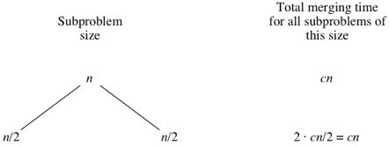
Analysis of Merge Sort

Slide 31
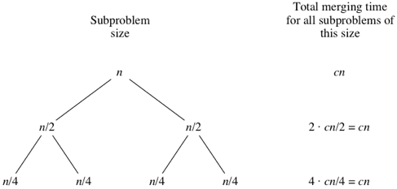
Continue..

Slide 32
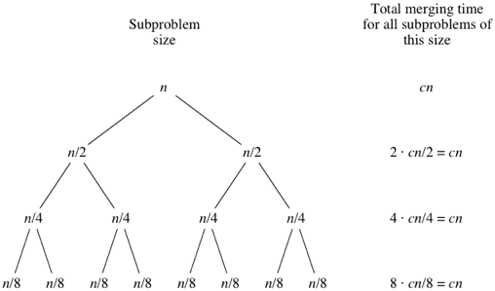
Continue…

Slide 33
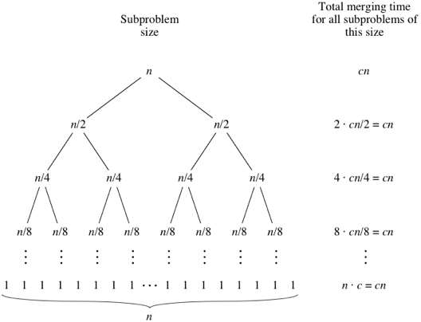
Continue…

Slide 34
Complexity of MergeSort
Pass Number | Number of merges | Merge list length | # of comps / moves per merge
1 | 2^{k-1} or n/2 | 1 or n/2^{k} | ≤ 2¹
2 | 2^{k-2} or n/4 | 2 or n/2^{k-1} | ≤ 2²
3 | 2^{k-3} or n/8 | 4 or n/2^{k-2} | ≤ 2³
. | . | . | .
. | . | . | .
. | . | . | .
k – 1 | 2¹ or n/2^{k-1} | 2^{k-2} or n/4 | ≤ 2^{k-1}
k | 2⁰ or n/2^{k} | 2^{k-1} or n/2 | ≤ 2^{k}
k = log n

Slide 35
Complexity of MergeSort
Multiplying the number of merges by the maximum number of comparisons per merge, we get:
(2^{k-1})2¹ = 2^{k}
(2^{k-2})2² = 2^{k}
•
•
•
(2¹)2^{k-1} = 2^{k}
(2⁰)2^{k} = 2^{k}
k passes each require 2^{k} comparisons (and moves). But k = lg n and hence, we get lg(n) • n comparisons or O(n lgn)

Slide 36
Program
void merge(int arr[], int l, int m, int r)
{
int i, j, k;
int n1 = m - l + 1;
int n2 = r - m;
/* create temp arrays */
int L[n1], R[n2];
/* Copy data to temp arrays L[] and R[] */
for (i = 0; i < n1; i++)
L[i] = arr[l + i];
for (j = 0; j < n2; j++)
R[j] = arr[m + 1+ j];

Slide 37
Continue..
/* Merge the temp arrays back into arr[l..r]*/
i = 0; // Initial index of first subarray
j = 0; // Initial index of second subarray
k = l; // Initial index of merged subarray
while (i < n1 && j < n2){
if (L[i] <= R[j]) {
arr[k] = L[i];
i++;
}
else{
arr[k] = R[j];
j++;
}
k++;
}

Slide 38
Continue...
/* Copy the remaining elements of L[], if there are any */
while (i < n1) {
arr[k] = L[i]; i++; k++;
}
/* Copy the remaining elements of R[], if there
are any */
while (j < n2)
{
arr[k] = R[j];
j++;
k++;
}
}

Slide 39
Continue…
/* l is for left index and r is right index of the sub-array of arr to be sorted */
void mergeSort(int arr[], int l, int r){
if (l < r) {
// Same as (l+r)/2, but avoids overflow for large l and h
int m = l+(r-l)/2;
// Sort first and second halves
mergeSort(arr, l, m);
mergeSort(arr, m+1, r);
merge(arr, l, m, r);
}
}

Slide 40
Continue…
/* UTILITY FUNCTIONS */
/* Function to print an array */
void printArray(int A[], int size)
{
int i;
for (i=0; i < size; i++)
printf("%d ", A[i]);
printf("\n");
}

Slide 41
Continue…
/* Driver program to test above functions */
int main()
{
int arr[] = {12, 11, 13, 5, 6, 7};
int arr_size = sizeof(arr)/sizeof(arr[0]);
printf("Given array is \n");
printArray(arr, arr_size);
mergeSort(arr, 0, arr_size - 1);
printf("\nSorted array is \n");
printArray(arr, arr_size);
return 0;
}

Slide 42
Output
Given array is
12 11 13 5 6 7
Sorted array is
5 6 7 11 12 13

